Slide 1
Re burgess ventures
By: eric vara

Slide 2
Our Mission Statement: The purpose of the RE Burgess Ventures database is to provide a robust and secure method to maintain the accuracy and integrity of property sales data while eliminating confusion. It will serve each department by providing the necessary data needed to execute their respective objectives in an easy and understandable way. The database will also be easily accessible and user-friendly to each authorized user on a variety of platforms.

Slide 3
mission objectives for re burgess ventures database:
Track properties and connected entities assigned to it.
Ability to generate a report that provides an overall snapshot of the project.
Should be user friendly to both the client and employee.
Each entity will have customized access to the database which will provide them with data in accordance with their role.
Data should be synchronous between all users.
Ability to track and assign tasks between each required entity.
Database will require the input of a unique password from each user.
Make the database compact and efficient to facilitate ease of back up.

Slide 4
Entity relationship diagram

Slide 5
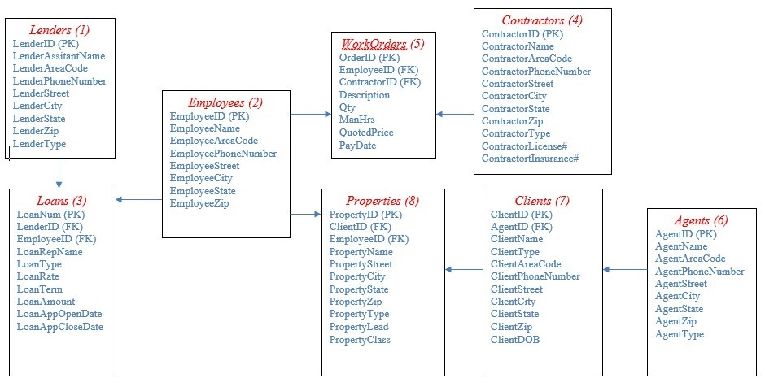

Slide 6
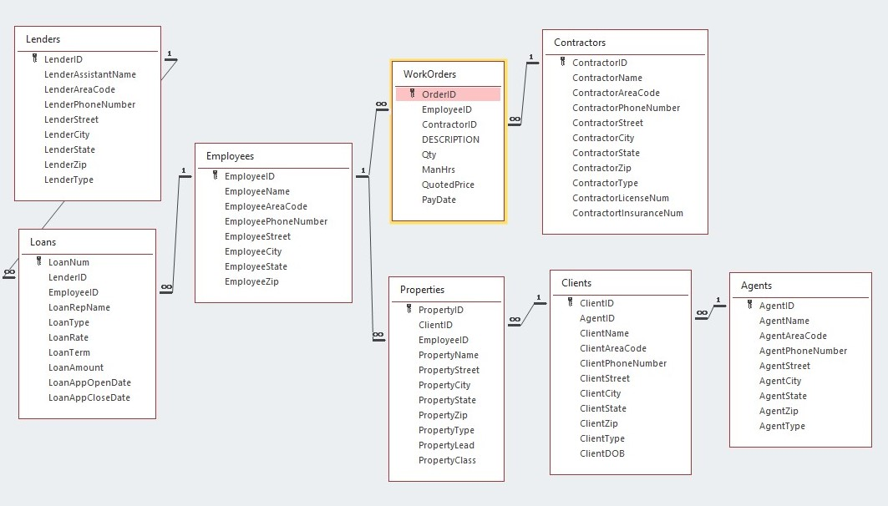

Slide 7
DATA DICTIONARY

Slide 8
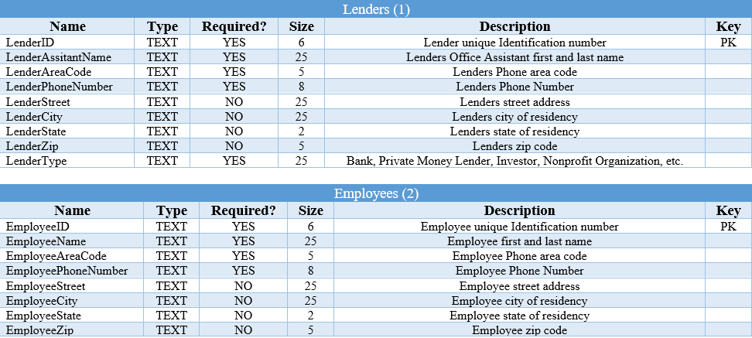

Slide 9
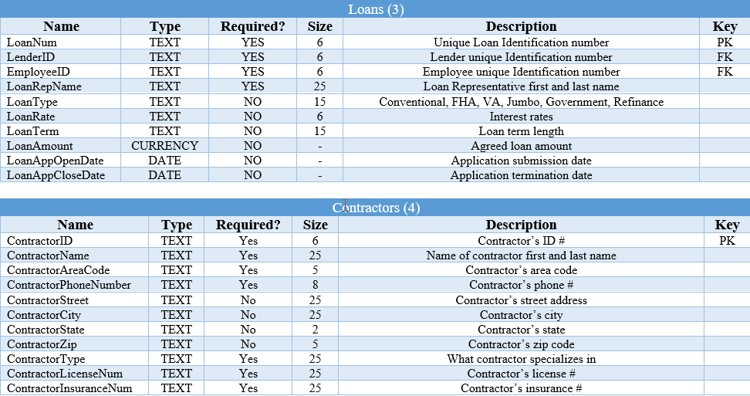

Slide 10
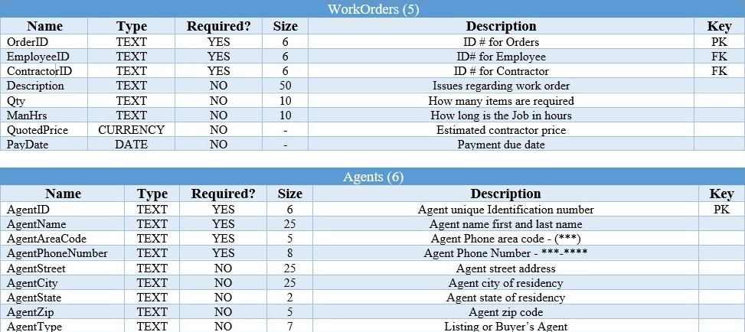

Slide 11
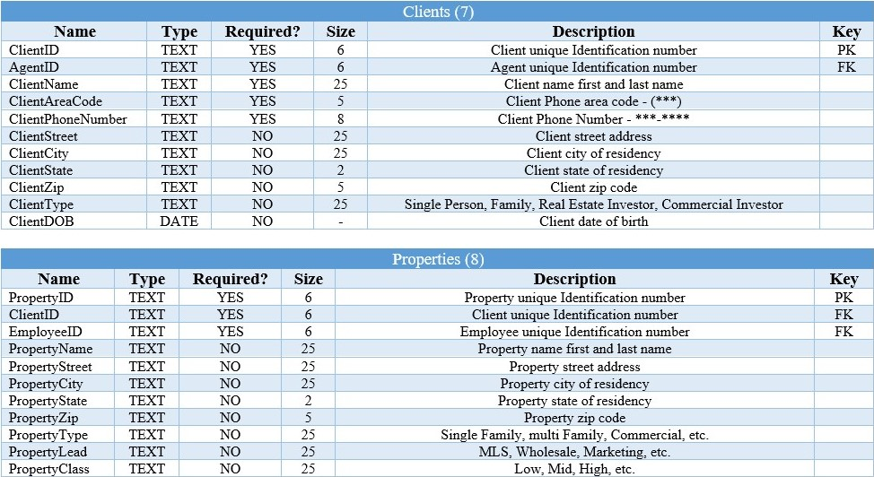

Slide 12
SQL For create table and insert data

Slide 13
CREATE TABLE Lenders
(LenderID TEXT (6) NOT NULL PRIMARY KEY,
LenderAssistantName TEXT (25) NOT NULL,
LenderAreaCode TEXT (5) NOT NULL,
LenderPhoneNumber TEXT (8) NOT NULL,
LenderStreet TEXT (25),
LenderCity TEXT (25),
LenderState TEXT (2),
LenderZip TEXT (5),
LenderType TEXT (25));
INSERT INTO Lenders VALUES
("123456", "Jane Jade", "(926)", "598-9655", "37 Lorraine st. ", "Highland", "CA", "09889", "Private Money Lender");
("234567", "James Smith", "(896)", "962-6894", "12 Collins st.", " Fayetville", "NC", "88512", "Wells Fargo");
("345678", "James Babin", "(596)", "957-2687", "1462 Stallion trl.", "Victorville", "CA", “ 44869", "USAA");
("456789", "Jayme Lagodzinski", "(348)", "157-6349", "58738 Fox Trail way", "San Bernardino", "CA", "41440", "Private Money Lender");
("567891", "James Donnersbach", "(910)", "593-4993", "1335 Northstar way", "Katy", "TX", "59636", "Navy Federal Crdit Union");

Slide 14
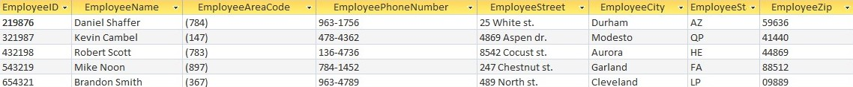
CREATE TABLE Employees
(EmployeeID TEXT (6) NOT NULL PRIMARY KEY,
EmployeeName TEXT (25) NOT NULL,
EmployeeAreaCode TEXT (5) NOT NULL,
EmployeePhoneNumber TEXT (8) NOT NULL,
EmployeeStreet TEXT (25),
EmployeeCity TEXT (25),
EmployeeState TEXT (2),
EmployeeZip TEXT (5));
INSERT INTO Employees VALUES
("219876", "Daniel Shaffer", "(784)", "963-1756", "25 White st.", "Durham", "AZ", "59636");
("321987", "Kevin Cambel", "(147)", "478-4362", "4869 Aspen dr. ", "Modesto", "QP", "41440");
("432198", "Robert Scott", "(783)", "136-4736", "8542 Cocust st.", "Aurora", "HE", "44869");
("543219", "Mike Noon", "(897)", "784-1452", "247 Chestnut st.", "Garland", "FA", "88512");
("654321", "Brandon Smith", "(367)", "963-4789", "489 North st.", "Cleveland", "LP", "09889");

Slide 15
CREATE TABLE Loans
(LoanNum TEXT (6) NOT NULL PRIMARY KEY,
LenderID TEXT (6) NOT NULL,
EmployeeID TEXT (6) NOT NULL,
LoanRepName TEXT (25) NOT NULL,
LoanType TEXT (15),
LoanRate TEXT (6),
LoanTerm TEXT (15),
LoanAmount CURRENCY,
LoanAppOpenDate DATE,
LoanAppCloseDate DATE,
FOREIGN KEY(LenderID) REFERENCES Lenders(LenderID),
FOREIGN KEY(EmployeeID) REFERENCES Employees(EmployeeID));
INSERT INTO Loans VALUES
("543219", "567891", "219876", "Theadore Warren", "Jumbo", "1.48%", "15 Year Term", “ 300000", #12/25/2028#, #09/01/2043#);
("654321", "456789", "321987", "Darren Greer", "VA", "2.36%", "18 Year Term", "170000", #6/06/2021#, #11/23/2039#);
("765432", "345678", "432198", "Kathleen Phillips", "Hard Money", "15.55%", "16 Year Term", "200000", #5/25/2020#, #06/01/2036#);
("876543", "234567", "543219", "Kevin Shelton", "FHA", "1.59%", "12 Year Term", "150000", #2/16/2018#, #08/01/2030#);
("987654", "123456", "654321", "Bernard Sherman", "Conventional", "2.52%", "30 Year Term", "250000", #3/25/2015#, #09/01/2045#);

Slide 16
CREATE TABLE Contractors
(ContractorID TEXT (6) NOT NULL PRIMARY KEY,
ContractorName TEXT (25) NOT NULL,
ContractorAreaCode TEXT (5) NOT NULL,
ContractorPhoneNumber TEXT (8) NOT NULL,
ContractorStreet TEXT (55),
ContractorCity TEXT (25),
ContractorState TEXT (2),
ContractorZip TEXT (5),
ContractorType TEXT (25) NOT NULL,
ContractorLicenseNum TEXT (25) NOT NULL,
ContractortInsuranceNum TEXT (25) NOT NULL);
INSERT INTO Contractors VALUES
("111222", "Sam Goody", "(928)", "555-6666", "125 Easy Street", "Kingman", "Arizona", "86409", "Cement", "111111-1111-111111-11", "222222-2222-333333-44");
("222333", "Mike Hall", "(928)", "666-8888", "1235 Marcy Street", "Prescott", "Arizona", "86488", "Electrical", "108675-1535-887645-66", "897123-8574-983412-99");
("325476", "Lisa Starr", "(928)", "665-4712", "1335 Easy J Street", "Kingman", "Arizona", "86409", "Paint", "985473-6347-172645-87", "874123-6347-854723-56");
("357841", "Sammy King", "(928)", "887-5631", "1254 Rusty Street", "Kingman", "Arizona", "86409", "Drywall", "854123-7845-789632-22", "324756-2244-964257-87");
("568741", "Tim Barry", "(928)", "885-3471", "1235 Lainey Street", "Kingman", "Arizona", "86410", "Cement", "874214-3247-987425-22", "123745-2543-423187-88");

Slide 17
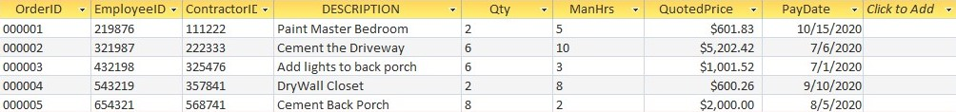
CREATE TABLE WorkOrders
(OrderID TEXT (6) NOT NULL PRIMARY KEY,
EmployeeID TEXT (6) NOT NULL,
ContractorID TEXT (6) NOT NULL,
Description TEXT (50),
QTY TEXT (10),
ManHrs TEXT (10),
QuotedPrice CURRENCY,
PayDate DATE,
FOREIGN KEY(EmployeeID) REFERENCES Employees(EmployeeID),
FOREIGN KEY(ContractorID) REFERENCES Contractors(ContractorID));
INSERT INTO WorkOrders VALUES
("000001", "219876", "111222", "Paint Master Bedroom", "2", "5", "601.83", #10/15/2020#);
("000002", "321987", "222333", "Cement the Driveway", "6", "10", "5202.42", #07/06/2020#);
("000003", "432198", "325476", "Add lights to back porch", "6", "3", "1001.52", #07/01/2020#);
("000004", "543219", "357841", "DryWall Closet", "2", "8", "600.26", #09/10/2020#);
("000005", "654321", "568741", "Cement Back Porch", "8", "2", "2000.00", #08/05/2020#);

Slide 18
CREATE TABLE Agents
(AgentID TEXT (6) NOT NULL PRIMARY KEY,
AgentName TEXT (25) NOT NULL,
AgentAreaCode TEXT (5) NOT NULL,
AgentPhoneNumber TEXT (8) NOT NULL,
AgentStreet TEXT (25),
AgentCity TEXT (25),
AgentState TEXT (2),
AgentZip TEXT (5),
AgentType TEXT (7));
INSERT INTO Agents VALUES
("A00001", "James Kirk", "(928)", "101-1234", "123 Enterprise Way", "Starfleet", "NV", "93427", "Listing");
("A00002", "Jean Luc Picard", "(928)", "201-2345", "234 France Drive", "Starfleet", "NV", "93427", "Listing");
("A00003", "Katherine Janeway", "(928)", "301-3456", "765 Voyager Road", "Academy", "AZ", "93451", "Listing");
("A00004", "Benjamin Sisko", "(928)", "210-4567", "987 Worm Hole Lane", "Academy", "AZ", "93451", "Buying");
("A00005", "Jonathan Archer", "(928)", "110-5678", "548 Porthos Drive", "San Francisco", "CA", "93111", "Buying");

Slide 19
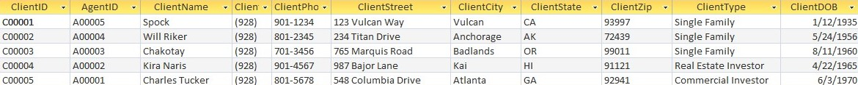
CREATE TABLE Clients
(ClientID TEXT (6) NOT NULL PRIMARY KEY,
AgentID TEXT (6) NOT NULL,
ClientName TEXT (25) NOT NULL,
ClientAreaCode TEXT (5) NOT NULL,
ClientPhoneNumber TEXT (8) NOT NULL,
ClientStreet TEXT (25),
ClientCity TEXT (25),
ClientState TEXT (2),
ClientZip TEXT (5),
ClientType TEXT (25),
ClientDOB Date,
FOREIGN KEY(AgentID) REFERENCES Agents(AgentID));
INSERT INTO Clients VALUES
("C00001", "A00005", "Spock", "(928)", "901-1234", "123 Vulcan Way", "Vulcan", "CA", "93997", "Single Family", #1/12/1935#);
("C00002", "A00004", "Will Riker", "(928)", "801-2345", "234 Titan Drive", "Anchorage", "AK", "72439", “Single Family", #5/24/1956#);
("C00003", "A00003", "Chakotay", "(928)", "701-3456", "765 Marquis Road", "Badlands", "OR", "99011", “Single Family", #8/11/1960#);
("C00004", "A00002", "Kira Naris", "(928)", "901-4567", "987 Bajor Lane", "Kai", "HI", "91121", "Real Estate Investor", #4/22/1965#);
("C00005", "A00001", "Charles Tucker", "(928)", "801-5678", "548 Columbia Drive", "Atlanta", "GA", "92941", "Commercial Investor", #6/03/1970#);

Slide 20
CREATE TABLE Properties
(PropertyID TEXT (6) NOT NULL PRIMARY KEY,
ClientID TEXT (6) NOT NULL,
EmployeeID TEXT (6) NOT NULL,
PropertyName TEXT (25),
PropertyStreet TEXT (25),
PropertyCity TEXT (25),
PropertyState TEXT (2),
PropertyZip TEXT (5),
PropertyType TEXT (25),
PropertyLead TEXT (25),
PropertyClass TEXT (25),
FOREIGN KEY(ClientID) REFERENCES Clients(ClientID),
FOREIGN KEY(EmployeeID) REFERENCES Employees(EmployeeID));
INSERT INTO Properties VALUES
("P00001", "C00001", "654321", "Ceti Alpha V", "999 Kahn Way", "Botany Bay", "AZ", "93401", "Single Family", "MLS", "Low");
("P00002", "C00003", "543219", "Alpha Centari", "3472 Milky Way Drive", "Kingman", "AZ", "39876", "Multi Family", "MLS", "Mid");
("P00003", "C00002", "432198", "Risa", "2222 Happy Road", "Oatman", "AZ", "86398", "Commercial", "Wholesale", "High");
("P00004", "C00005", "321987", "Kronos", "9871 Klingon Lane", "Golden Valley", "AZ", "86409", "Single Family", "Marketing", "Low");
("P00005", "C00004", "219876", "Veridian IV", "5482 Terran Way", "Kingman", "AZ", "86401", "Multi Family", "Wholesale", "High");

Slide 21
queries

Slide 22
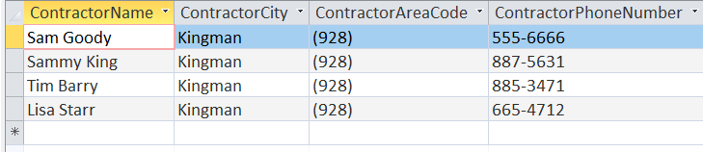
SELECT ContractorName, ContractorCity, ContractorAreaCode, ContractorPhoneNumber
FROM Contractors
WHERE ContractorCity = "Kingman";

Slide 23
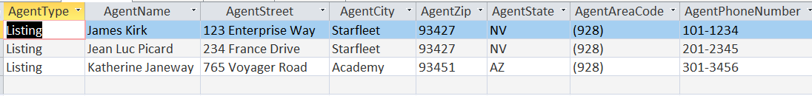
SELECT AgentType, AgentName, AgentStreet, AgentCity, AgentZip, AgentState, AgentAreaCode, AgentPhoneNumber
FROM Agents
WHERE AgentType = "Listing";

Slide 24
SELECT ClientName AS Client, ClientAreaCode AS Area_Code, ClientPhoneNumber AS Phone, PropertyName,PropertyStreet, PropertyCity, PropertyType, PropertyClass
FROM Clients, Properties
WHERE Clients.ClientID = Properties.ClientID
AND PropertyType = "Single Family";

Slide 25
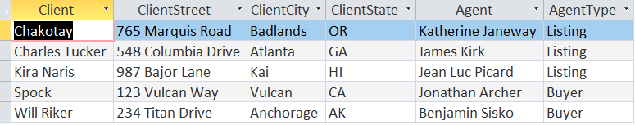
SELECT ClientName AS Client, ClientStreet, ClientCity, ClientState, AgentName AS Agent, AgentType
FROM Clients, Agents
WHERE Clients.AgentID = Agents.AgentID
ORDER BY Clients.ClientName;

Slide 26
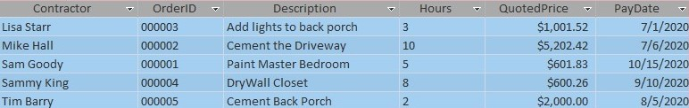
SELECT ContractorName AS Contractor, WorkOrders.OrderID, Description, ManHrs AS Hours, QuotedPrice, OrderDate, PayDate
FROM WorkOrders, Contractors
WHERE WorkOrders.ContractorID = Contractors.ContractorID
ORDER BY Contractors.ContractorName;

Slide 27
views

Slide 28
(Partial View)
CREATE VIEW LoanOfficer AS
SELECT *
FROM Lenders, Loans
WHERE Lenders.LenderID = Loans.LenderID;

Slide 29
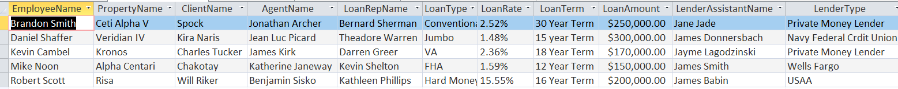
CREATE VIEW EmployeeSimple AS
SELECT EmployeeName, PropertyName, ClientName, AgentName, LoanRepName, LoanType, LoanRate, LoanTerm, LoanAmount, LenderAssistantName, LenderType
FROM Employees, Properties, Clients, Agents, Loans, Lenders
WHERE Employees.EmployeeID = Properties.EmployeeID
AND Properties.ClientID = Clients.ClientID
AND Clients.AgentID = Agents.AgentID
AND Employees.EmployeeID = Loans.EmployeeID
AND Loans.LenderID = Lenders.LenderID
ORDER BY Employees.EmployeeName;

Slide 30
(Partial View)
CREATE VIEW EmployeeComplete AS
SELECT *
FROM Properties, Employees, Clients, Agents, Loans, Lenders
WHERE Employees.EmployeeID = Properties.EmployeeID
AND Properties.ClientID = Clients.ClientID
AND Clients.AgentID = Agents.AgentID
AND Employees.EmployeeID = Loans.EmployeeID
AND Loans.LenderID = Lenders.LenderID
ORDER BY Properties.PropertyID;

Slide 31
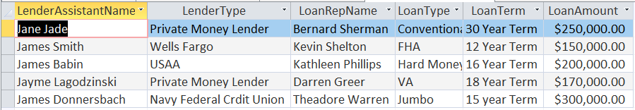
CREATE VIEW LoanOfficerSimple AS
SELECT LenderAssistantName, LenderType, LoanRepName, LoanType, LoanTerm, LoanAmount
FROM Lenders, Loans
WHERE Lenders.LenderID = Loans.LenderID;

Slide 32
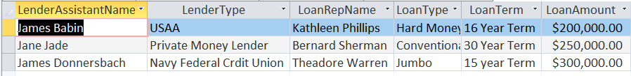
CREATE VIEW LoanOfficerSimpleMinimum AS
SELECT LenderAssistantName, LenderType, LoanRepName, LoanType, LoanTerm, LoanAmount
FROM Lenders, Loans
WHERE Lenders.LenderID = Loans.LenderID
AND LoanAmount >=200000
ORDER BY Loans.LoanAmount;

Slide 33
FORMS

Slide 34
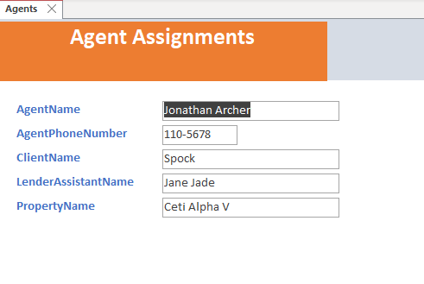

Slide 35
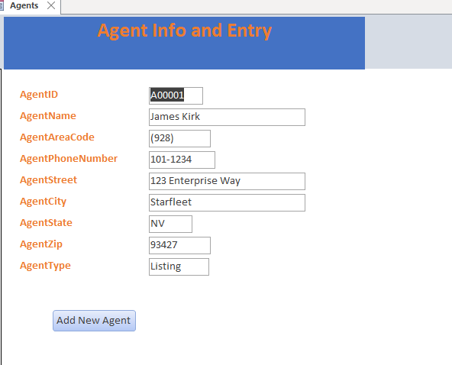

Slide 36
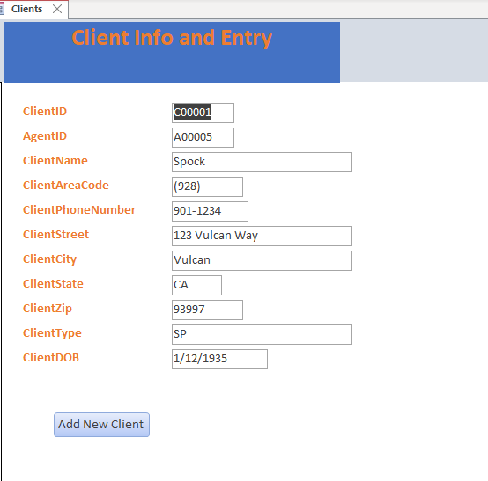

Slide 37
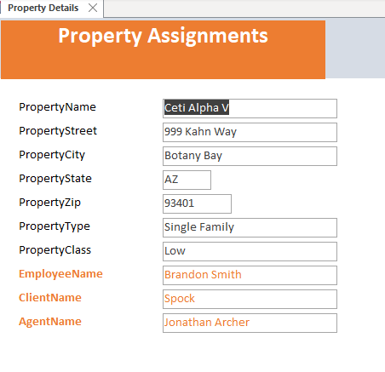

Slide 38
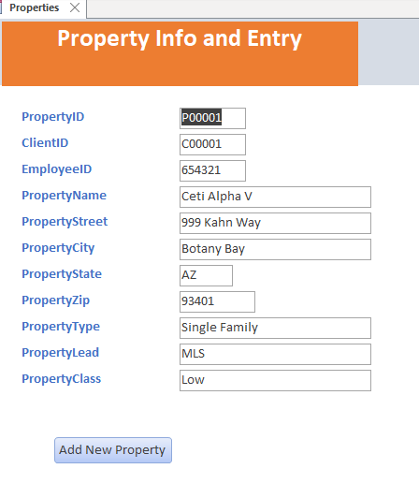

Slide 39
REPORTS

Slide 40
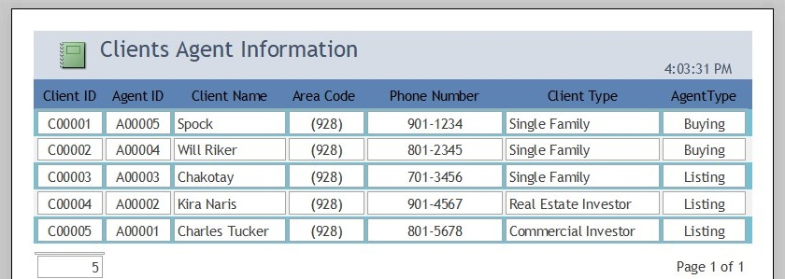

Slide 41
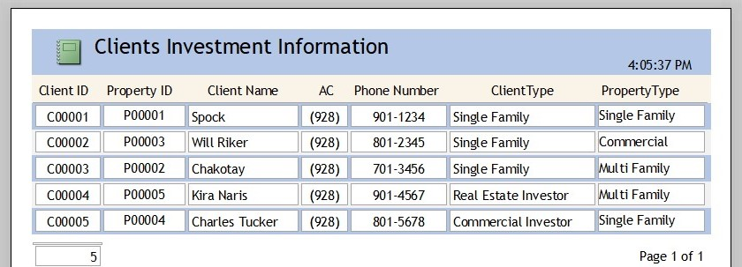

Slide 42
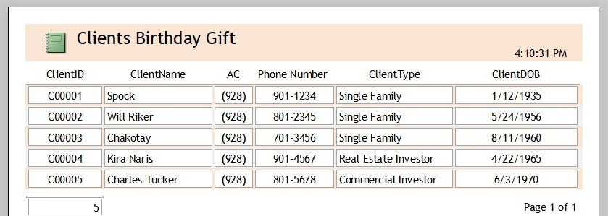

Slide 43
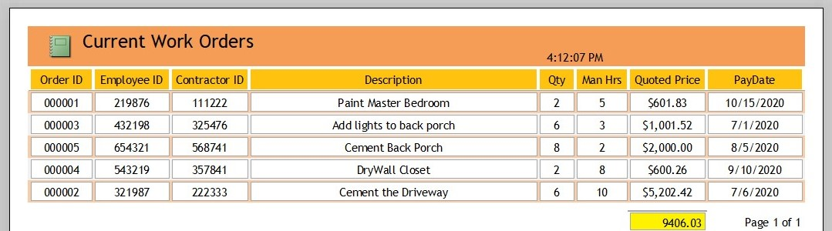

Slide 44
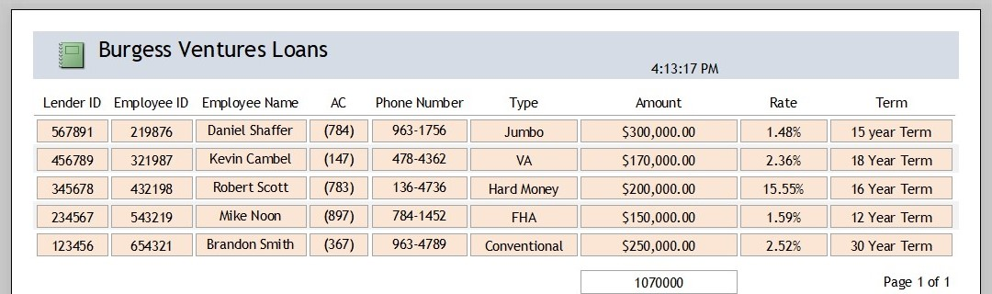

Slide 45
Summary
Throughout the endeavor, several lessons were learned. I learnt that if each phase isn't finished correctly, the entire process would become more difficult. If I wasn't sufficiently prepared to move on to the next step, I'd have to go back and adjust my previous work. I had to backtrack and complete ideas along the way as I moved through the job without full planning. Each stage must be accomplished before moving on, otherwise there will be no obvious way to the next.
Constructing the various table relationships was another amazing lesson. It was quite simple for me to understand how to visually see how it operates from a bird's eye view. Physically planning for the following steps by observing how the tables interacted was quite beneficial. As I previously stated, putting these safeguards in place before moving forward was possibly the most important lesson of all. In the beginning, I struggled with this and was obliged to go back and change earlier steps whenever I wanted to update something in subsequent steps.
Overall, I've learned the value of thoroughly finishing measures along the route in order to achieve innovative productivity, transparency, and project deadlines. Along the road, I learnt how much more I can avoid the learning process if I communicate and plan effectively. Every step of the road was a blast, and I learnt a lot of exciting lessons along the way.

